Slide 1
雷陨沙海
关卡设计文档
29/04/2025

Slide 2
区域「雷殒沙海」主题
区域概念
「雷殒沙海」是一片被无尽黄沙与裸露岩层覆盖的荒漠，位于新大陆边缘的裂谷地带。这里常年被雷暴云笼罩，沙暴与闪电交织成致命天灾，地表则因地下晶矿能量外泄形成「雷蚀流沙」—— 沙粒带电，触碰后会引发麻痹或爆炸。区域中心矗立着巨型雷击岩柱，其顶部吸收雷电能量形成天然避雷针，成为生物争夺的能量核心。
怪物生态
基础生物群: 雷甲蝎 （小型生物） 沙核虫 （环境生物） 晶冠秃鹫 （中立生物） 中层掠食者: 裂电蜥龙 （飞龙种）
自然环境
地表：无尽黄沙与裸露岩层覆盖的荒漠 LOCATION: Chinatown BRIEF SYNOPSIS: The fresh water supply in Chinatown has broken down and a large group of refugees are relocating north. Make contact with the group and escort them to the Manhattan Bridge collection point. Coordinate your effort with Agent Sarah Kelly, already on site.
Notes:
This slide is the “executive summary” global overview of the mission to present all its key info in one slide

Slide 3
MISSION ID: MM01
MISSION TITLE: “First Wave part I”
育碧专页
MISSION TIME
Evening of Dec 20th, 20XX
NARRATIVE GOALS (must be conveyed to player during the mission, by gameplay, dialogue, or cutscene)
Primary goal: Establish the mid-crisis world of The Division. Introduce Agent Kelly, Angela Chen and Kevin Zeng. Establish Kelly as tough, kind and dependable. Establish Angela Chen as kind and caring. Establish Kevin Zeng as somewhat of a hothead. Seconcary goal: Expose how the government is fast breaking down, with the JTF fracturing and the freshly activated first-wave agents barely holding up against the collapse. Expose the dog-eat-dog world Manhattan is fast becoming, with violence & rioters in the streets on the rise. Hint at the future relationships between Angela Chen, Keving Zeng and Agent Kelly. Hint at Kelly’s displeasure with the overall government response to the crisis. Tertiary goal: N/A
LOCAL CONTEXT & LORE (“behind the scene” reasons for what is seen during the mission)
It’s close to Christmas, and many still aim to celebrate Christmas, despite the crisis. The President has just activated Directive 51 and the First Wave Division Agents (activated from 18th to 20th of Dec). Manhattan is not yet quite as desolate as it will be in January, but it’s fast getting there. Rioters are taking over the streets, and there are rumors about the inmates having escaped from Rikers Island. The JTF is barely holding together and are hard pressed to enforce the government directives surrounding the quarantine. Many believe a complete pullout is imminent. The fresh water supply to Chinatown has collapsed, which is why they are moving north to a refugee camp (which will become the Spring Blossom Settlement). Agent Kelly comes of as a tough and dependable ally with a kind heart. But at one point she vents her frustration with the Government, and another side of her comes through.
NARRATIVE NEEDS
The outbreak intro cinematic is key to establish the situation and make it clear to the player what is going on, and who he is as an Agent of the Division. A proper introduction of Agent Kelly, Angela Chen and Kevin Zeng is key, as they play the main parts in the story to follow. A Cutscene dedicated to that moment is probably necessary.
Notes:
This slide is the “narrative key points” of the missions, the key intentions that will be used in STEP 2 when writing the scripts and storyboards.
This slide is to be used to direct the writing of “must-have dialogue lines” and storyboard outlines, to ensure coherency, plot info exposition, and proper character tone.
This slide must be written by narrative designers

Slide 4
「雷殒沙海」—— 怪物生态
区域BOSS
雷渊主君·迦尔纳罗斯 （古龙种） 作为雷殒沙海的能量主宰，其活动引发雷暴频率激增，迫使其他生物迁徙避让。龙形躯体缠绕电弧，翼膜由雷云构成，核心为悬浮的「雷殒之瞳」，可操控区域天气与电磁场。尾部嵌入晶矿形成链状闪电鞭。 战斗机制 ： P1阶段——雷击岩柱：雷主利用雷击岩柱作为屏障，玩家需将岩柱导电反击。雷主释放「雷殒新星」全屏冲击波，可躲入流沙坑规避。 P2阶段——雷云融合：与雷暴云合体，化身半透明电磁体，攻击附带麻痹与磁场牵引效果，需击落岩柱制造绝缘区域。 P3阶段——雷爆过载：核心过载自毁，引发连锁雷爆与沙海塌陷，玩家需在限时内破坏其尾部能量链。
中层掠食者
裂电蜥龙（飞龙种） 背鳍如避雷针吸收雷电，尾部可发射高压电球，栖息于雷击岩柱顶端。 特殊机制：狂暴时召唤雷暴锁定玩家，需破坏其背鳍中断能量吸收。 砂暴铠鳄（兽龙种） 体表覆盖绝缘砂铠，可蜷缩成球引发沙尘冲锋，潜行于流沙中突袭。 特殊机制：砂铠被击碎后暴露脆弱肉质，但会主动吞噬沙粒快速修复。
基础生物群
雷甲蝎（小型甲壳） 甲壳储存电能，受威胁时释放电弧，群体活动可形成电网封锁路径。 沙核虫（小型爬行） 钻入沙地制造流沙漩涡，玩家可投掷诱饵引导其破坏怪物巢穴。 晶冠秃鹫（中型鸟类） 飞行生物，以雷晶矿为食，俯冲攻击时会释放带电羽毛，击杀后掉落「雷蚀羽片」用于制作抗电装备。
Notes:
This slide is the “narrative key points” of the missions, the key intentions that will be used in STEP 2 when writing the scripts and storyboards.
This slide is to be used to direct the writing of “must-have dialogue lines” and storyboard outlines, to ensure coherency, plot info exposition, and proper character tone.
This slide must be written by narrative designers

Slide 5
Location outline

Slide 6
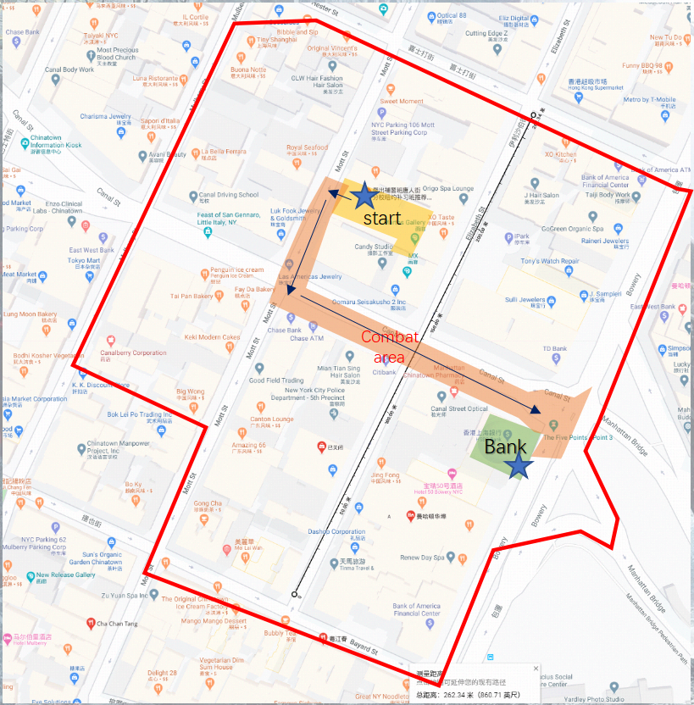
MISSION LOCATION MAP
Note, this map you proposed is a good example of the level of zoom expected here.
The mission route presented might have to be revised to fit the gameplay & narrative flow
It would need to highlight all the locations & key sites of the mission:
JTF checkpoint
Refugees gathering point
HSBC bank road block
JTF pick-up point
Notes:
A map of the mission location is great to already have if possible (even if rough & vague at this STEP 1). This is just an example, not the right map for mission 1.
If not available yet, it would have to be made at start of STEP 2

Slide 7
MISSION ID: MM01
MISSION TITLE: “First Wave part I”
DIFFICULTY ESTIMATE
BUDGET: Gold mission | DURATION: 15 min
GAMEPLAY BLOCKS
(Copy paste gameplay block here)
(Copy paste gameplay block here)
(Copy paste gameplay block here)
(Copy paste gameplay block here)
(Copy paste gameplay block here)
(Copy paste gameplay block here)
(Copy paste gameplay block here)
(Copy paste gameplay block here)
Cinematic
Go To
Cinematic
Go To
Kill
Dialogue
Defend / Scripted sequence
Cinematic
MISSION STEPS / PLAYER’S JOURNEY
Intro cinematic explains the outbreak and the activation of First Wave SHD agents, transitioning into character creation (menu step). Player arrives at JTF checkpoint and meets with Local JTF Commander. Is asked to help escort Chinese refugees. Player goes to the refugee gathering point in Chinatown. Possible light combat along the way. Meets with refugee leader Angela Chen and another Division Agent named Kelly at the gathering point. Kelly and Player then scout ahead together to clear the way for the refugees. They encounter and defeat small groups of Rioters. Arriving at the HSBC Bank building PC and Kelly must destroy a Rioter road block. The refugees begin to move. PC learns that a large group of rioters is approaching along Canal street from the West. They must be held off until the slow-moving refugees are secure. PC and Kelly together with a few JTF make a stand and hold off the Rioters while the refugees move to safety. The Rioters try to ram a stolen army truck through the Player’s position, but they are stopped (exotic enemy & scripted sequence) Having defeated the rioters, PC rejoins the refugees at the JTF pick-up point and receives their gratitude. Kelly gets a call from her close friend Dr O’Neill who reports heavy trouble at a Wall Street field hospital. PC and Kelly must go there.
SUCCESS CONDITION
PC completes all the tasks/steps
FAIL CONDITION
N/A
HOSTILES
Rioters Rioter Boss
FRIENDLIES
Agent Kelly (AI companion) JTF personnel (AI companions)
ANIMALS & EXOTICS
Stolen US Army truck (exotic enemy)
NEW INGREDIENTS INTRO
Movement & cover systems Combat & classes skills Basic Rioters enemy archetypes
KEY REWARDS
??? TIMI TO DETAIL
Notes:
* This slide is the “level design summary” of the mission, the key intentions and structure that will be used in STEP 2 to build the “mission skeleton” and work on LD
* This slide must be build by level designers + narrative designers working together

Slide 8
MISSION ID: MM01
MISSION TITLE: “First Wave part I”
育碧专页
CINEMATIC INTENTION: “OUTBREAK” INTRO
The cinematic must establish the situation and make it clear to the player what is going on, and who he is as an Agent of the Division Key points to expose The virus spread through infected dollar bills, from Black Friday on Nov 23rd NYC locked down as disease cases appear from 1st to 5th of Dec The president orders military forces to seal off NYC on Dec 6th , WHO declares a pandemic on Dec 11th, and martial law is invoked on Dec 14th Civil unrest appears in NYC, surviving police & military forces form the JTF (joint task force) to handle it From 18th to 20th of December, the president activates Directive 51 to ensure continuity of the federal government during the crisis, and the first wave of SHD agents in NYC is activated TCTD1 intro video already does a great job of exposing all this https://www.youtube.com/watch?v=8lSNNyHzmc4 But it is done with real world footage, making it look extremely grim, dark and realistic, and very uncomfortable to watch know considering the coronavirus pandemic. So while we could re-use it, it’s probably not a good idea. Recommended to remake a similar intro cutscene with CGI instead of real world footage, and to try to downplay the details that have a lot of similarities with the real world pandemic (ie: masks, sold out pharmacies, people in ambulance, etc could be avoided) This is a sensitive topic where we would like Timi’s input regarding Chinese government approval expected result.
Notes:
This slide is the “narrative key points” of the missions, the key intentions that will be used in STEP 2 when writing the scripts and storyboards.
This slide is to be used to direct the writing of “must-have dialogue lines” and storyboard outlines, to ensure coherency, plot info exposition, and proper character tone.
This slide must be written by narrative designers

Slide 9
LOCATION IN THE WORLD
MAP / SECTORS
WORLD OVERVIEW
Notes:
This slide is to localize in which region of the OW the mission is, and in which area of that region, with maps
Note: examples from ACM of full OW map “world overview” to region’s sector zoomed-in map are below TDM examples

Slide 10
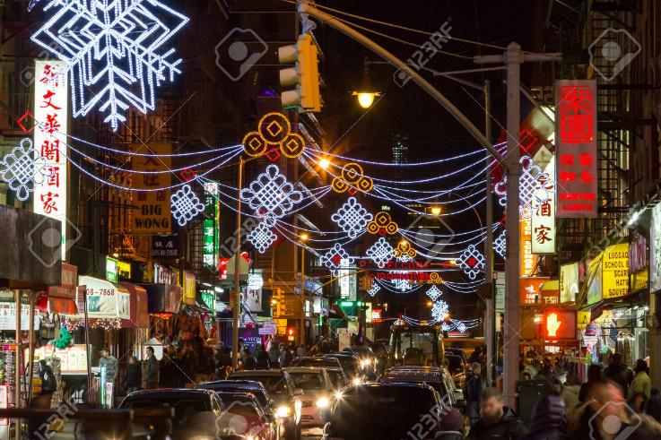
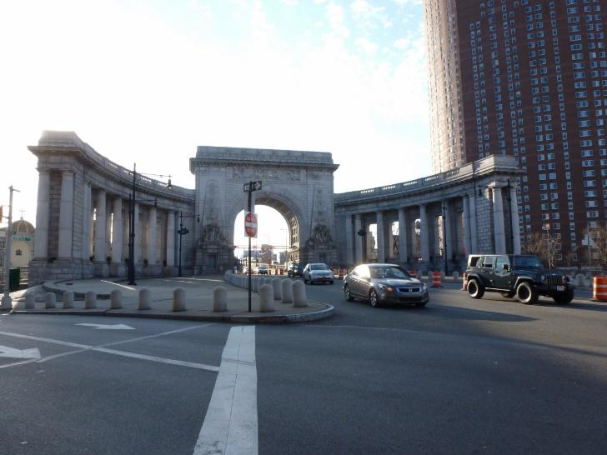
REGION IDENTITY - Chinatown, Manhattan NYC
Key visual references or concept arts go here
BIOME (geography, vegetation, architecture)
Small streets, low buildings Mid-level wealth of neighborhood Chinese signage & decorations Abandoned cars, junks in the streets
ICONIC LANDMARKS & KEY LOCATIONS
Chinatown streets with neon signs in Chinese HSBC Bank Building Manhattan Bridge Ramp
HUMAN PRESENCE
A few civilians preparing to evacuate, some stubbornly staying behind All commerce, shops, etc are closed A few civilians here and there – standing in windows and on balconies and moving furtively along the streets. A few rioters in the streets
KEY OW ACTIVITIES
N/A (this is not a true OW region, but a special mission “mini OW” map) EXAMPLE of what would go here for Midtown Manhattan OW regions: Enemy faction xxx control point Roaming patrols of enemy faction xxx
BACKSTORY (in real world)
Chinatown is a vibrant neighborhood in Lower Manhattan famous for it’s large Chinese-American population.
BACKSTORY (in TCTD lore)
Fresh water supply to Chinatown has broken down The local Division agents have just been activated The neighborhood is being evacuated
Notes:
Each region of the OW should have such “region ID sheet” created, so it is then easier to reference the mission location.
The “region ID” is basically a high-level version of the mission’s location outline.

Slide 11
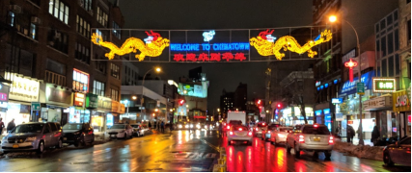
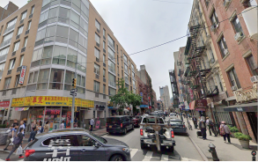
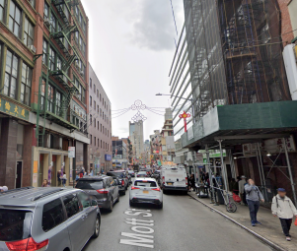
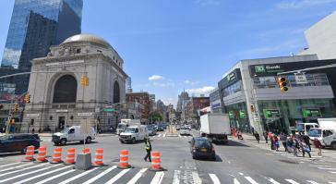
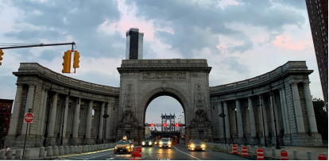
REGION VISUAL REFERENCES – Chinatown, Manhattan
Notes:
Visual references of the region’s biome and typical human presence in the region (fields, mines, cities, villages, etc) should be provided
Such boards as you already provided are perfect for that

Slide 12
LOCATION ID: XXXXX
LOCATION NAME: “JTF Checkpoint & Chinatown streets”
Key visual references or concept arts go here
BIOME (geography, vegetation, architecture)
Small streets, low buildings Mid-level wealth of neighborhood Chinese signage & decorations Abandoned cars, junks in the streets
LOCATION THEMATIC
At night Some large building burning off in the background Christmas decorations still visible
ART BUDGET FOCUS
Buildings on fire in the background, lighting up the sky
KEY SITES IN MISSION LOCATION
JTF Checkpoint Refugees gathering point JTF pick up point
ENVIRONMENTAL DETAIL SUGGESTIONS
People escaping the area with their most precious possessions Some very limited traffic weaving between abandoned cars? Stubborn citizens still putting up Christmas decorations Some large building burning off to the west.
LOCATION FUNCTION IN THE WORLD
Local bank of a commerical & residential area, now being evacuated
BACKSTORY (in TCTD lore)
Fresh water supply to Chinatown has broken down The local Division agents have just been activated The neighborhood is being evacuated
Notes:
Each specific location used in the mission should be referenced with such slide.
Normal missions happen in only one location, but since this is the first mission of the game, its mission design should also cover its questgiver location (JTF checkpoint).

Slide 13
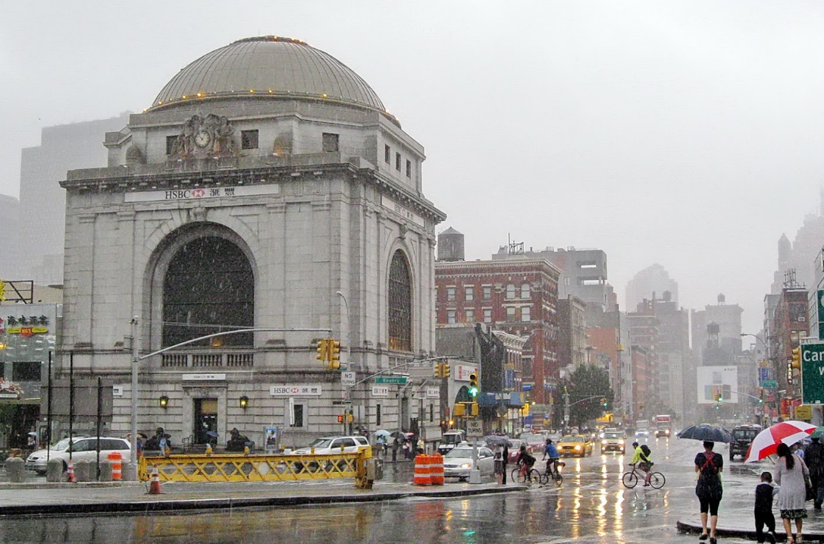
LOCATION ID: XXXXX
LOCATION NAME: “Chinatown’s HSBC bank”
Key visual references or concept arts go here
BIOME (geography, vegetation, architecture)
Small streets, low buildings Mid-level wealth of neighborhood Chinese signage & decorations Abandoned cars, junks in the streets
LOCATION THEMATIC
At night Some large building burning off in the background Christmas decorations still visible
ART BUDGET FOCUS
Buildings on fire in the background, lighting up the sky
KEY SITES IN MISSION LOCATION
Rioters roadblock
ENVIRONMENTAL DETAIL SUGGESTIONS
N/A
LOCATION FUNCTION IN THE WORLD
Local bank of a commerical & residential area, now being evacuated
BACKSTORY (in TCTD lore)
Fresh water supply to Chinatown has broken down The local Division agents have just been activated The neighborhood is being evacuated
Notes:
Each specific location used in the mission should be referenced with such slide.
Normal missions happen in only one location, but since this is the first mission of the game, its mission design should also cover its questgiver location (JTF checkpoint).

Slide 14
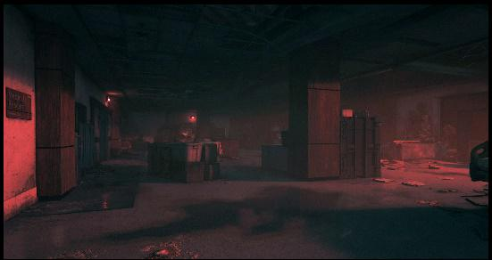
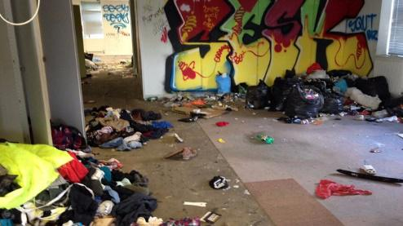


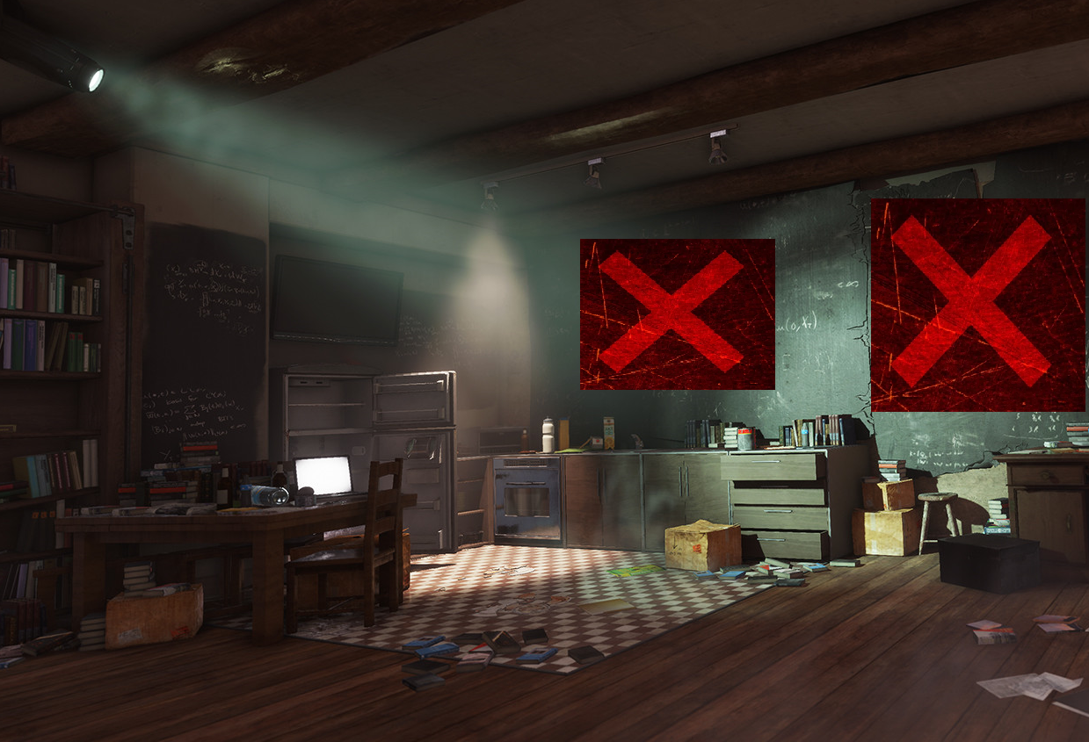
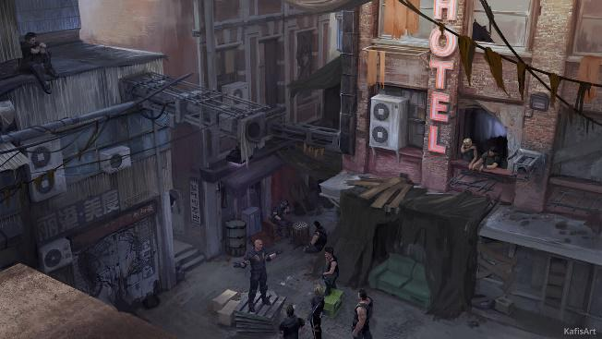
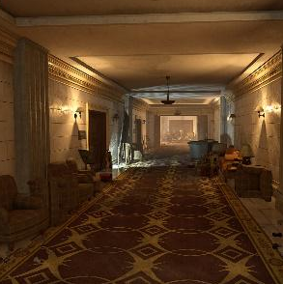
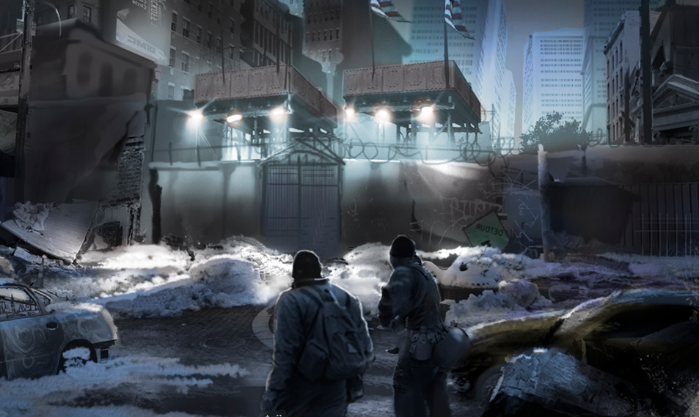
MISSION LOCATION MAP REFERENCE
Arsenal
Living
Area
Echo
BOSS
Colosseum
Exit
Dungeon
Gate
Open Area
Underground
Building Interior
Entrance
Arsenal

Slide 15
APPENDIX

Slide 16
GAMEPLAY BLOCKS TEMPLATE OBJECTS
Prepare easy to copy/paste template boxes of your gameplay blocks, based on your list & definitions
Those can then easily be copy/pasted into the mission structure and level design slides of the mission (see “mission outline” slides and “step 2” slides for examples in the template)
Fight
Navigation
Stealth
Interaction
Narrative
Other
Assassinate
Chase
Infiltrate
Activate/Get
Go To Cinematic
Puzzle
Defend
Follow
Tail
Locate
Play Cinematic
Pets
Escort
Go To
Cinematic
Underwater
Destruction
Kill
Escape
Walk & Talk
Exotic gameplay
Destroy
Tracking
Dialogue
Sabotage
Climbing
Scripted event

